Slide 1

Politecnico di Milano
A.A. 2015-2016
Hypermedia Applications project:
Design part
IDM C/L/P design + interactive mock-up
Delivery date: 16 May 2016
Alessandro Pozzi
(ID: 852358 Email: alessandro10.pozzi@mail.polimi.it)
Marco Romani
(ID: 852361 Email: marco.romani@mail.polimi.it)

Slide 2
C / L / P IDM DIAGRAMS

Slide 3
Introduction
The first section of this document contains the C/L/P IDM diagrams for the Hypermedia Applications project, along with some notes about the notation used and the decisions that have been taken.
In the second and last section, the general structure of the Mock-up pages is shown. Here are provided some comments that should be read before looking into the interactive mock-up.

Slide 4
Technical notes
The mock-ups have been created with Pencil. If you open the Pencil source file, just ignore the “resource missing” errors you may get, since they do not influence at all the mock-up navigation.
Documentation and IDM diagrams have been written in English. However, since TIM’s website content is strictly in Italian, we have decided to present the mockup in Italian. In particular, the (English) name of the pages in the P-IDM is shown again before each page in the mockup, so that the correlation becomes easier. However, for the instances of the multiple topics, we decided to use this kind of naming convention: Product1, Product2, etc. and Product(association_source) if the page is reached through a transition.

Slide 5
C-IDM
Promotions
All devices categories
Device by category
Smart Life by categories
Device
For Device(s)_1 [1,30]
Smart Life
All Smart Life categories
All devices
Available SL
Service [1,5]
All Smart Life
The group
Assistance For
[1,10]
For Device(s)_2
[1:10]
Assistance by category
Assistance Service
All assistance categories
Who we are
Highlights
All Assistance services

Slide 6
Note on the C-IDM diagram
Even if it wasn’t explicitly stated in the specification, we have decided to add the following group of topics:
All devices
All smart life
All assistance services
Which represents respectively the complete set of devices, smart life and assistance services. We think that such lists could be useful to the user, especially in a future possible implementation of a filter system.

Slide 7
L-IDM
Promotions
All devices categories
Device by category
Device
For device(s)_1
[1,30]
Smart Life
Smart Life by categories
Characteristics
Technical features
Promotion
Description
Benefits
How to
Promotion
All Smart Life categories
All devices
Available SL service [1,5]
All Smart Life
Assistance
For [1,10]
For device(s)_2
[1,10]
Assistance
service
Assistance by
category
Who we are
Business
Governance
Description
FAQs
Testimonials
Innovations
Projects
Market aspects
For investors
Description
Governance
Highlights
All assistance categories
All Assistance services
News

Slide 8
Note on the L-IDM diagram
We have decided to fragment the “THE GROUP” single topic into the following topics:
Business
Governance
News
Such decision have been taken in order to avoid having a heap of not completely homogeneous content in a single place, like in the actual TIM site. This facilitates the user by addressing him directly into the information (s)he is looking for.
In particular, we wanted to give to the “News” section a more prominent role, as it will be shown in the next diagram.
The “Promotion” element have been added in the “Device” and “Smart Life” multiple topics to increase the clarity of the contents in such multiple topics, especially in relation with the “Promotions” introductory act. More details can be found in the P-IDM section.

Slide 9
P-IDM (part 1)
News
H
All devices categories
All assistance categories & Highlights
WHO WE ARE
All Smart Life categories
Testimonials
Innovations
Projects
A2A
All
devices
All Smart life
services
All
Assistance
services
GOVERNANCE
INDEX
Description
Governance
INDEX
INDEX
A2A
BUSINESS
Devices of category X
Smart Life
of
category X
Assistance
of
category X
I+GT
Market aspects
For investors
I+GT
I+GT
I+GT
I+GT
A2A
I+GT
INDEX

Slide 10
Promotions
I+GT
I+GT
I+GT
I+GT
I+GT
I+GT
Index
Index
Assistance
Service [50]
Index
Device [10,100]
Smart Life [10,50]
Characteristics
For device(s)_2
[1,10]
Characteristics
For Device(s)_1 [1,30]
Description
Benefits
A2A
I+GT
FAQs
*
Promotion
Technical features
How to
Promotion
A2A
*
*
I+GT
Available SL service [1,5]
Assistance for
[1,10]
I+GT
A2A
Index
P-IDM (part 2)
* -> optional pages

Slide 11
Notes on the P-IDM diagram
As stated in the L-IDM, we think that “News” should have a more relevant role. For this reason, it will also be a landmark well visible in any moment (see the mock-up).
Business and governance are logically separated so that the user can find quickly the information (s)he needs; however it is possible to navigate directly from one to the other. They are not landmarks, since in our opinion they are not information that need to be accessible from any page.
The “Promotion” page have been added in both the “Device” and “Smart Life” multiple topics. We thought it would be confusing for the user to do not find a section containing info about the promotions, especially if the user have reached that Device or Smart Life page from the “Promotions” introductory page! This also allow to quickly see if a product is in promotion.
“Highlights” have been merged with the introductory page of assistance services. A list of highlighted assistance services will be shown together with the possible category of assistances. In this way, if the user is interested in receiving an assistance, (s)he might immediately find the service (s)he need.

Slide 12
Similarly, Devices and Smart Life services in promotion have been merged into a single introductory page, to make it easier to have an overview of what is actually on promotion.
The relationship “available SL service” have been treated as a Transition Act inside the “Device” topic because of the very low (maximum 5) number of SL services associated. It will be possible to reach such SL services directly from the specific Device page.
The “Index + Guided Tour” pattern have been used in most cases, basically in all the occasion in which it had sense to be able to move between pages of the same group. Between “Promotions” and its specific instances (devices and/or SL in promotion) we have used the “Index” pattern, since there is no real correlation of specifications, characteristics and/or types among the set of things in promotion.

Slide 13
MOCK-UP

Slide 14
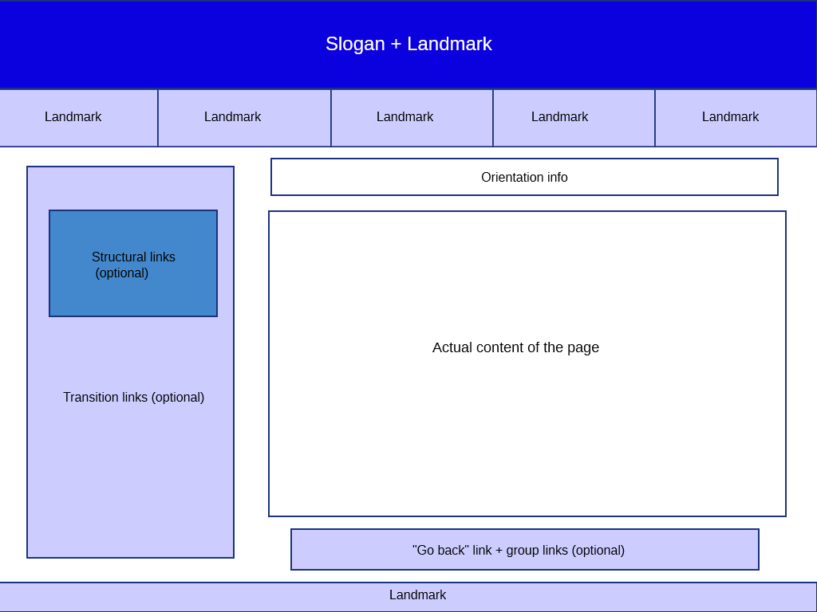
General structure of the mock-up pages:

Slide 15
Notes about the mockups
Since the number of possible navigation paths would make the number of static mock up pages increase exponentially, we decided to disable a considerable amount of links. However, each ‘’type of link’’ is available at least in one instance of the replicated pages. In particular, for the multiple topics, we suggest to follow the path ‘’categories-categoryX-topic1’’ which should provide an example of all functionalities.
We put in red the links that should appear in a page, but are not active in the mock ups.
The Assistance Services’ content has been simplified, compared to the one on TIM website, because it had a very deep and complex structure that would have been infeasible to represent in the mockups. The same thing is valid for the single topics which had a lot of more (confusing) content w.r.t the one indicated in the specification.

Slide 16
There is not always complete coherence between the introductory act pages and their content. For example we called the multiple group pages “CategoryX”, which means that it might not represent an actual category, and sometimes we put in it mixed content from the real categories. We made this choice because we wanted to take the content with best material from the web and because we think that the important part in this context is the structure of the pages, not the actual content.
For the same reason we created some transition pages associating products that in reality might not have any connection, especially in the case of Assistance Services that in the TIM website haven’t connections with anything.

